Slide 1

Bike-Sharing: Insight into Public Precautions During the COVID-19 Pandemic
Group 12:
Jenny Jang
Carol Moore
Elina Ribakova

Slide 2
Client’s Scrum Story
As a public health analyst, I want to see how bike-sharing changed during the COVID-19 pandemic, because it is one indicator of how the public is taking precautions or risks.

Slide 3
Study Design and Data
Many cities reported a spike in bicycle sales and bike sharing. In Chicago “unprecedented demand.”*
We performed month-to-month comparisons on Capital Bikeshare ridership to show to impact of the pandemic in the DC metro area.
Monthly trip data is provided by Motivate, which runs Capital Bikeshare on behalf of municipal governments in DC, VA and MD
25 monthly files
Each record is a trip; N=5.5M+
https://www.capitalbikeshare.com/system-data
*Chicago Metropolitan Agency for Planning (CMAP), "Pandemic presents opportunity for communities to
embrace biking and walking," website post, undated).

Slide 4
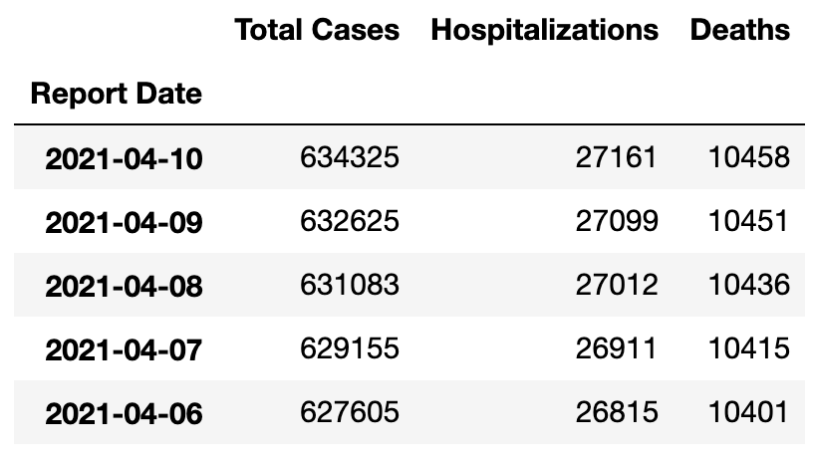
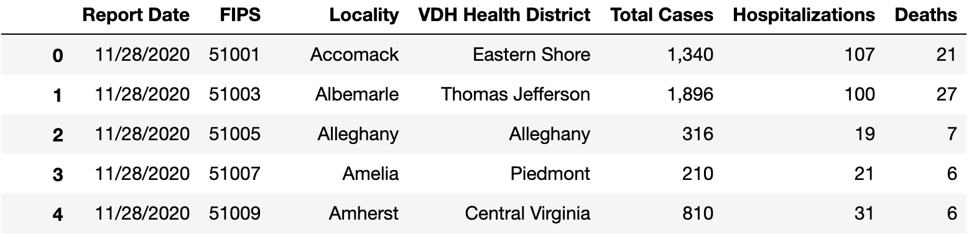
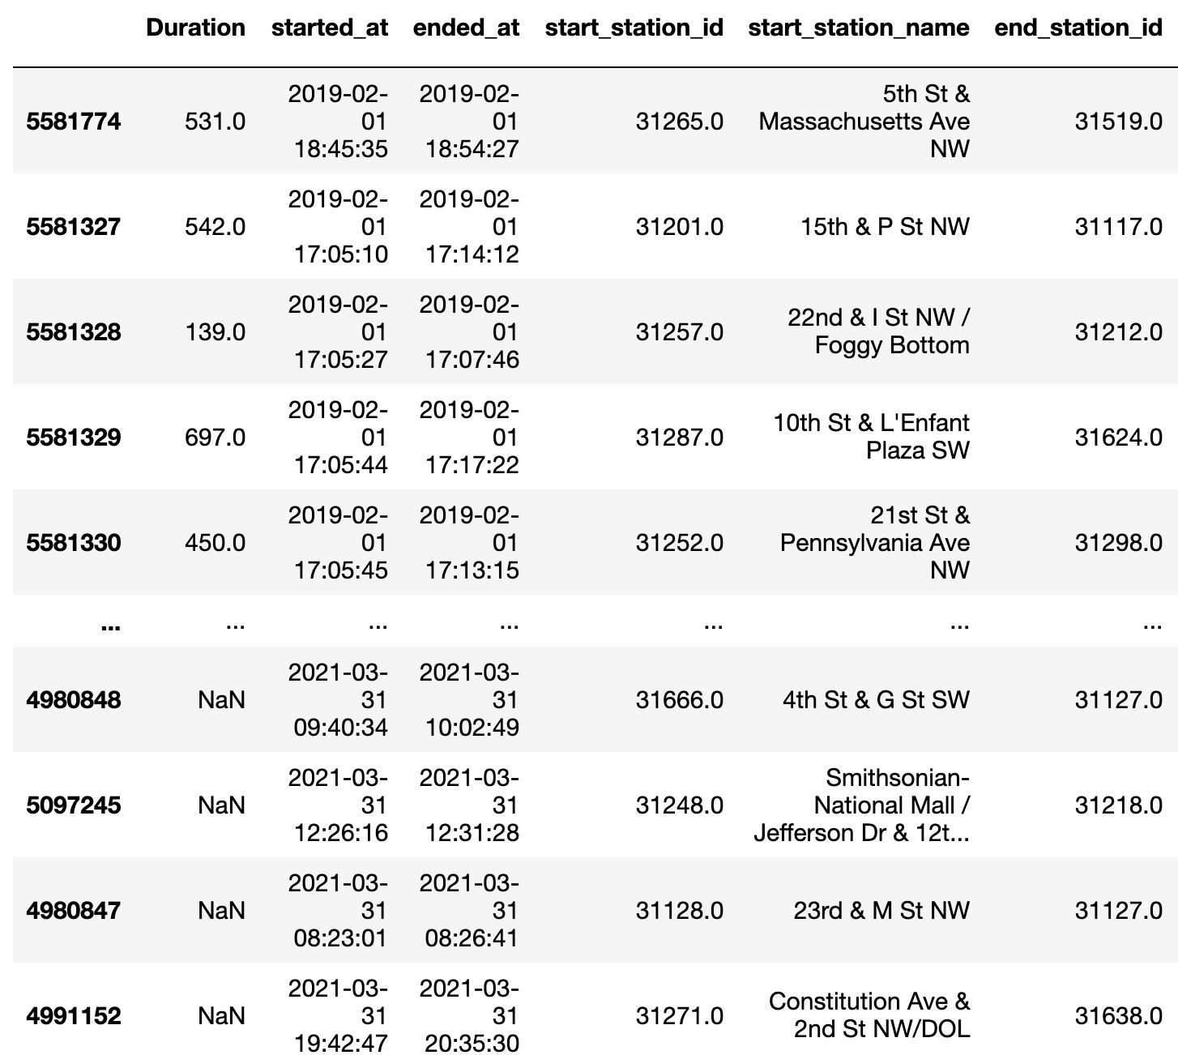
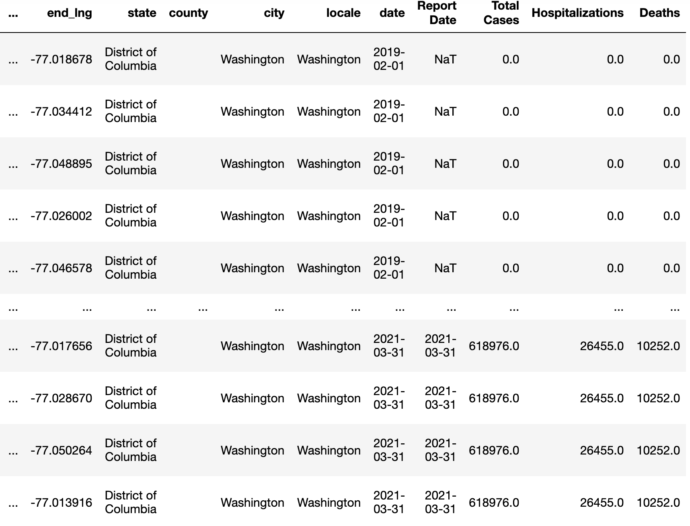
Data Pipeline: Merging Public Health Data
dataset from: https://data.virginia.gov/Government/VDH-COVID-19-PublicUseDataset-Cases/bre9-aqqr
We also wanted to see how bike sharing changed with key events in the pandemic and with cases rising
2. Added up counts grouping by the report date
3. And joined it to the Bike Share by date
5,737,818 rows × 25 columns

Slide 5
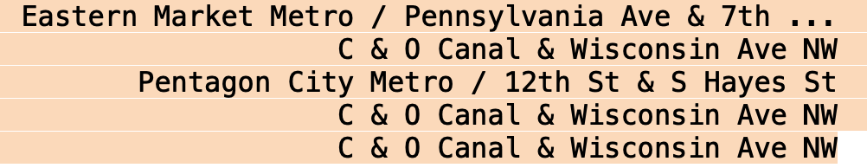
Data Pipeline: Location Data
Old Format
Address did not include State
Raw data had ~48K unique lat / longs in March 2021 alone…but only 600 stations
Solutions:
Clean lat/long by taking average per station
Reduce lat/long to a small table of about 600 unique values vice 5M+ records
Use GEOPY to reverse-code lat-long to get State, County, etc.
Merge new geographic vars into larger file
Once we got State, we decided to focus on Northern Virginia.
There 590,000 trips starting in VA Feb. 2019-March 2021

Slide 6
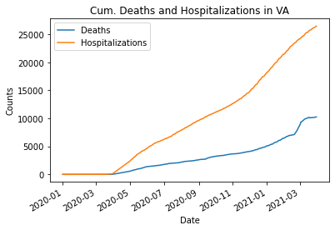
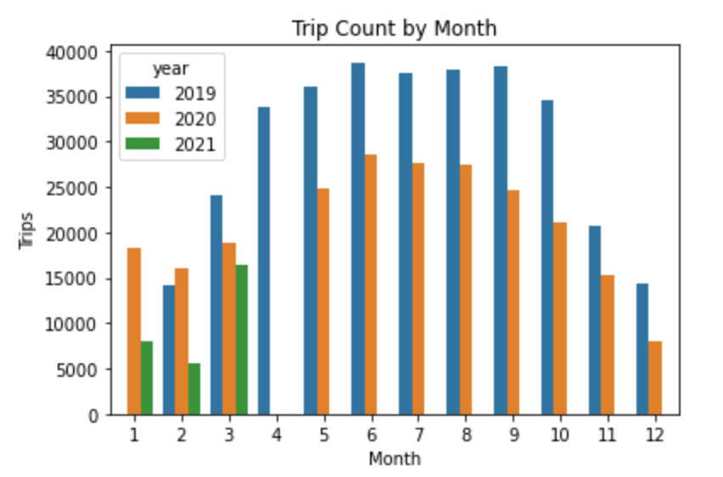
Key Events and Patterns
Feb 6, 2020: First US death
Mar 14: First Death in Virginia
Mar 30: VA Governor declares lockdown
May 4: VA begins to reopen

Slide 7
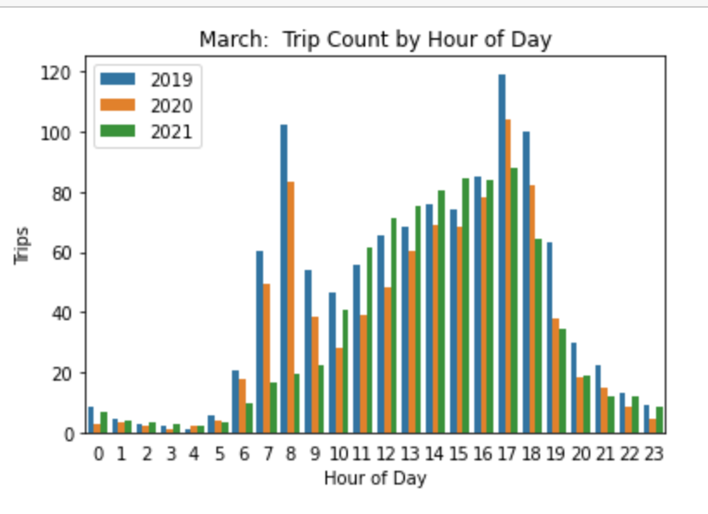
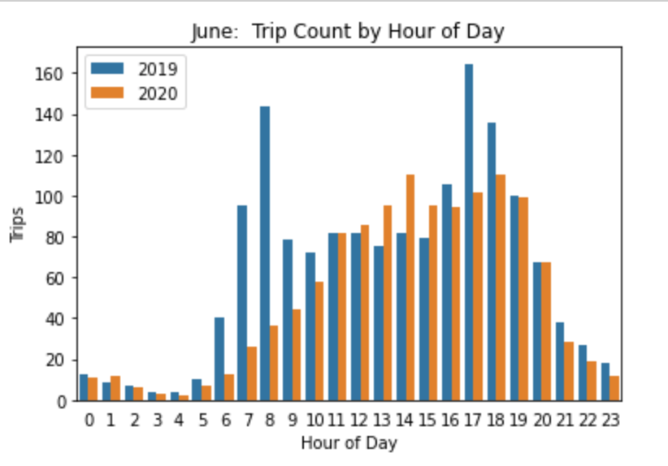
Impact on Time Choices Time of Day
Trips were down throughout the day in March 2020 compared to March 2029. But there were still a lot of trips during commuting hours.
By June, commuting hour trips were much lower than in 2019. But last afternoon trips were higher.

Slide 8
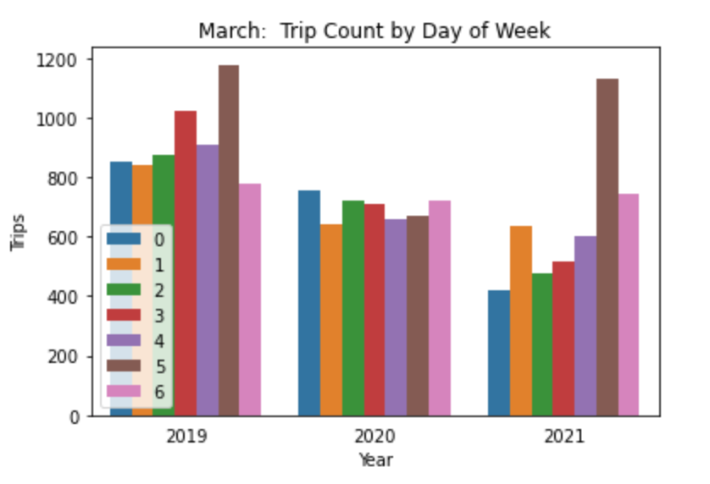
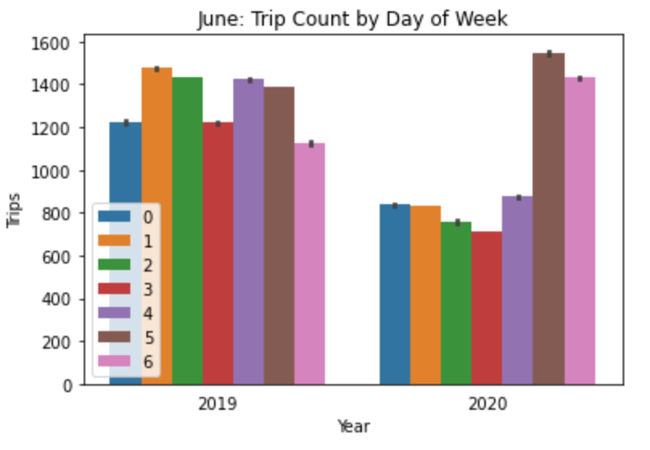
Impact on Time Choices Day of the Week
In March 2020 trips were way down every
day of the week.
By June, there were ~500 more weekend trips than in 2019.
Note: Monday is “0” and Sunday is “6”

Slide 9
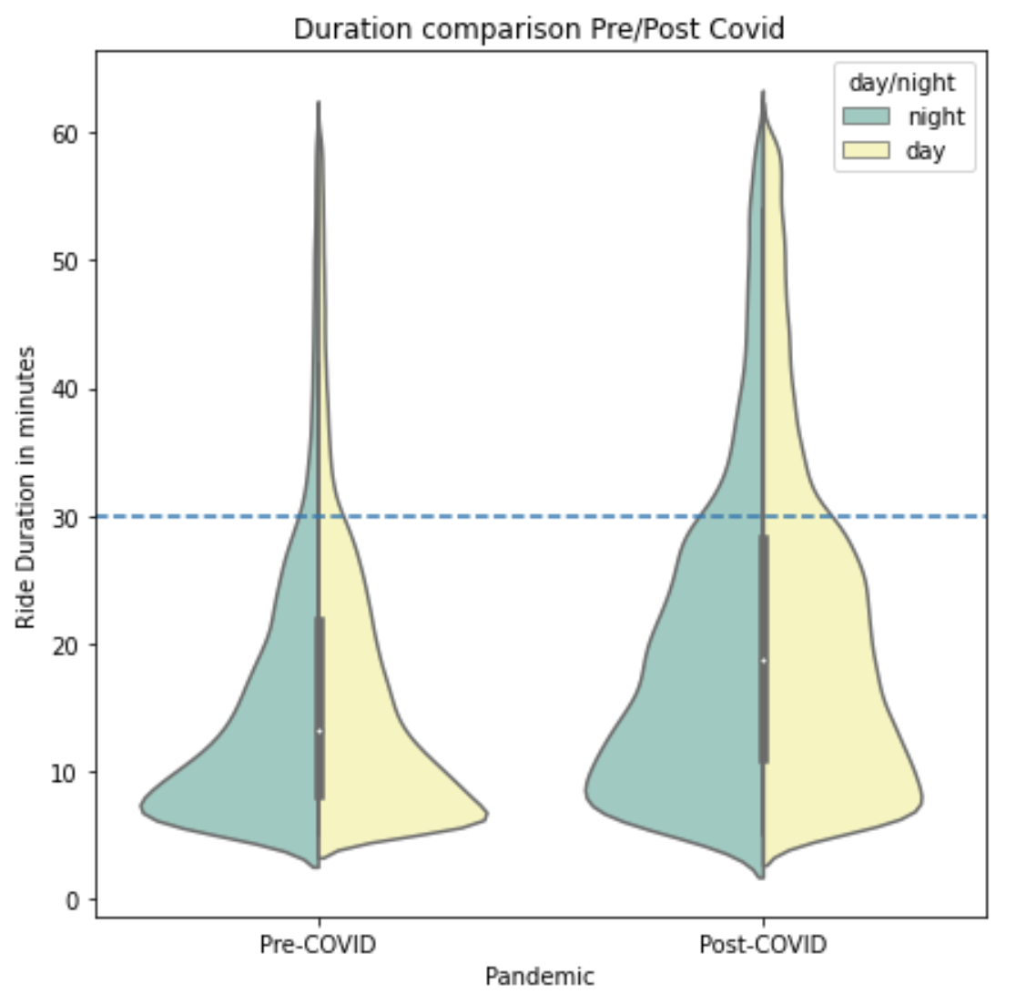
Impact on Duration
\
People take longer bike rides suggesting that they are riding bikes more for leisure or extended personal use rather than commuting to/from work!

Slide 10
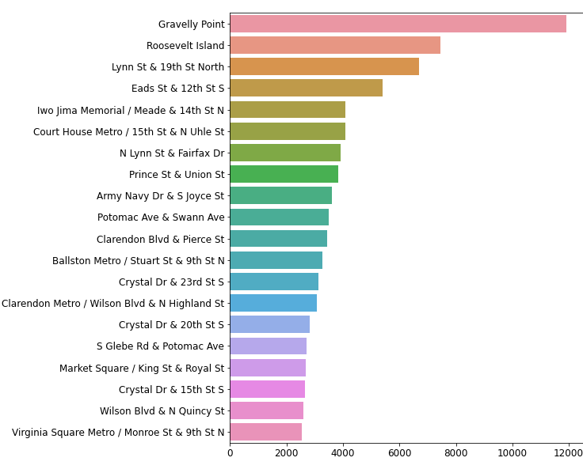
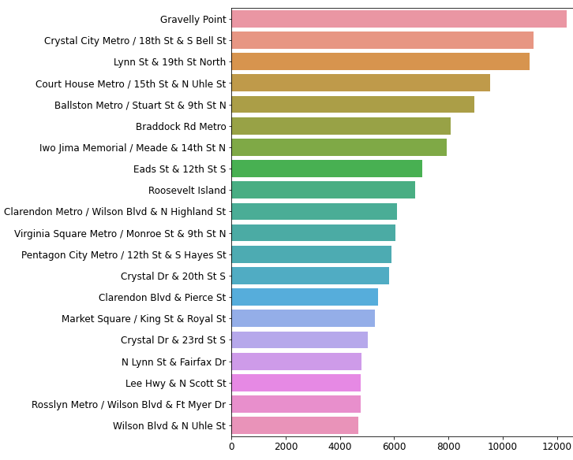
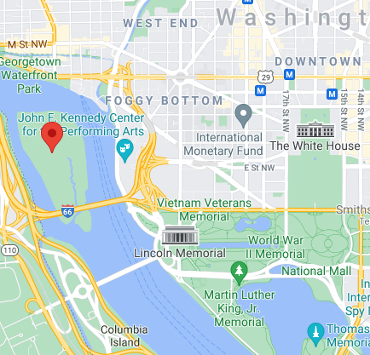
Impact on Stations Usage
Post-COVID19
People use stations that are near parks or recreational areas. Top 20 most used stations have changed markedly after the start of the pandemic.
Pre-COVID19

Slide 11
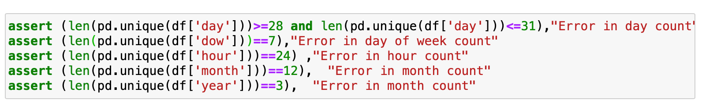
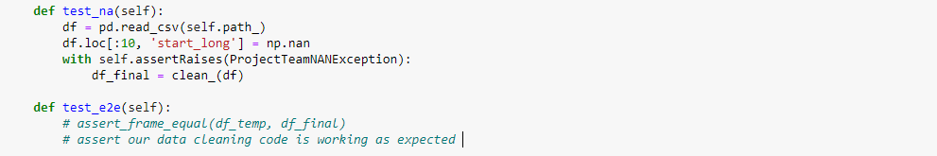
Testing
def test_na(self):
df = pd.read_csv(self.path_)
df.loc[:10, 'ride_id'] = np.nan
with self.assertRaises(ElinaNANException):
df_final = clean_(df)
def test_e2e(self):
We used a variety of testing methods, attempting to follow principles of Test-Driven Development
Assert statements. Example of tests to make sure time groups were correct
Testing our data processing. Example of data cleaning checks (nan) and end to end testing of the data cleaning part of the program.
Logical and empirical checks. Does our approach of taking the mean result in accurate locations?

Slide 12
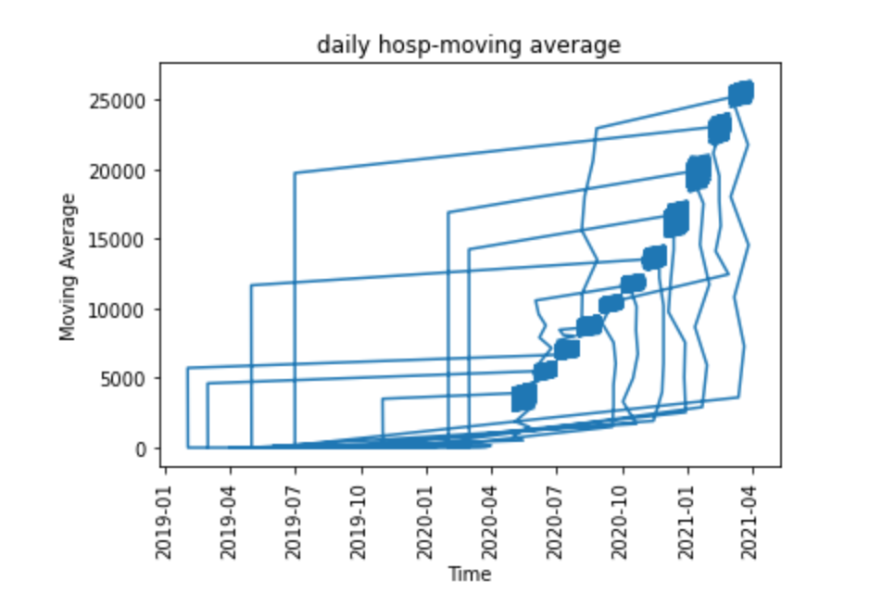
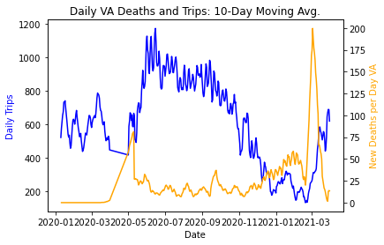
Technical Limitations / Things We Would Do With More Time
Technical Improvements in Visualizations
Create a “zero” file for April 2020 bikeshares
No data
April 2020
Rotate this axis!

Slide 13
Summary
Data | Source: Capital Bikeshare, the DC area’s public bike-sharing program. Scope: Rentals in Northern Virginia for the period Feb. 2019 – March 2021 Size: Each trip is a record in the data. N = 590,000 +
Information | Average monthly rentals fell ~25% March 2020-21 compared to previous year The reduction started in Feb. 2020, aligned to publicity about global outbreak Most of the drop was workdays and commuting times Biking for leisure has increased! Looping at usage time, duration, and stations
Knowledge / Utility | The public adjusted leisure time to include more bike-sharing The public should be educated on risks/benefits of using shared resources outdoors during COVID Possible adjustments to road sharing during the weekends and off-peak hours

Slide 14
Backup Slides

Slide 15
Another Scrum Story
As an urban planner I know that some states, like Illinois, set records in bike sharing during the pandemic indicating an “embrace of biking.”
Did this happen in the DC region too?

Slide 16
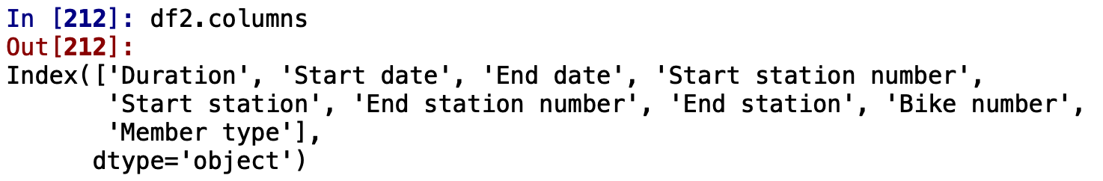
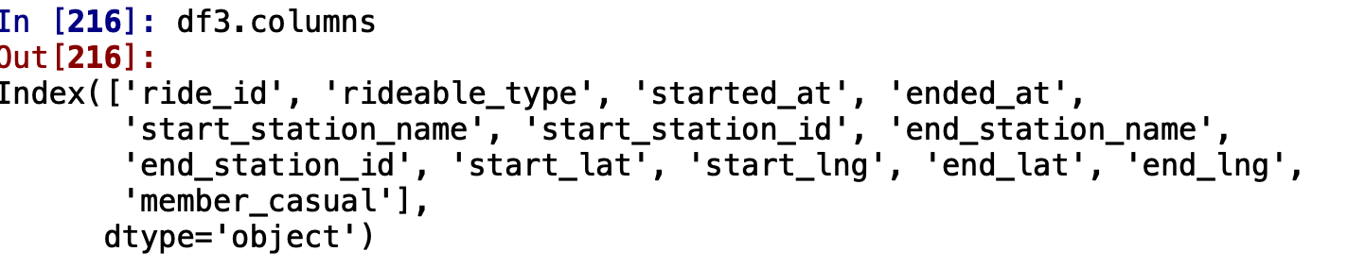
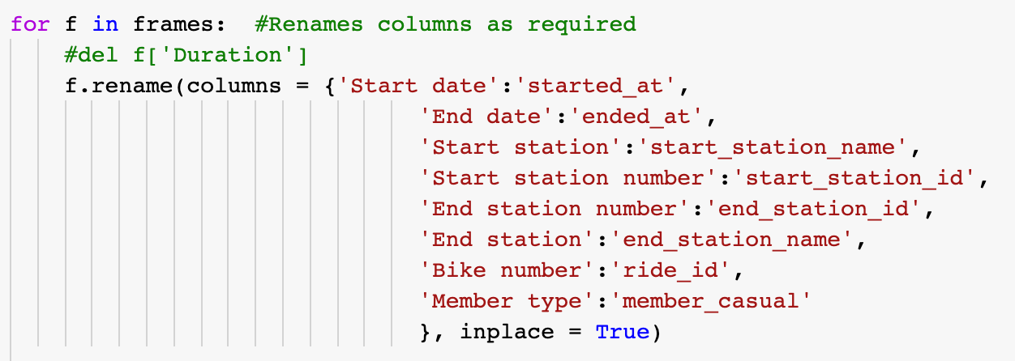
Data Pipeline: Cleaning and Concatenating Bike Share Files
We downloaded 25 monthly files
Feb 2019 ~ March 2021
missing April 2020
The files had inconsistent titles, content and formats which differed before and after 3/20
“Start date” vs. “Started at”
Lat/Long missing in earlier files
Station names increasingly missing
“Duration” missing from later files
We standardized columns which was the first step in data cleaning and transformation.
Columns Before March 2020
Columns After March 2020

Slide 17
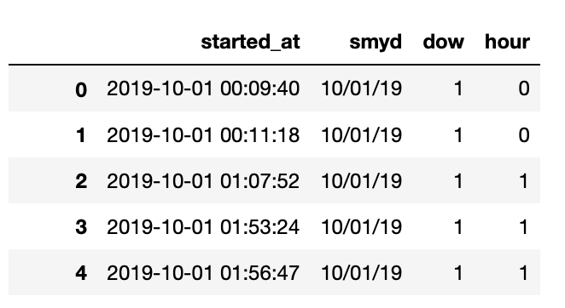
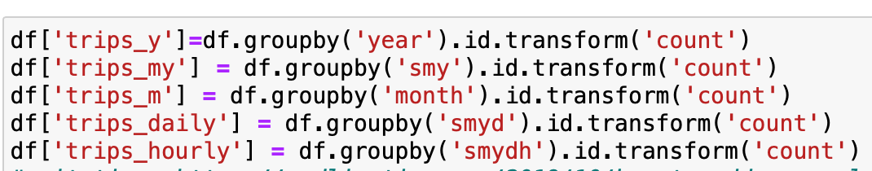
Data Pipeline: Grouping for Analysis
Convert timestamp data from YYYY:MM:DD:HH: MM:SS to more relevant time units like date, day of the week, or hour
Aggregate data into counts or means by time units
Since we wanted to do comparisons at different points in time this method was preferred to resampling alone.
Orig. Date/time
date

